Slide 1
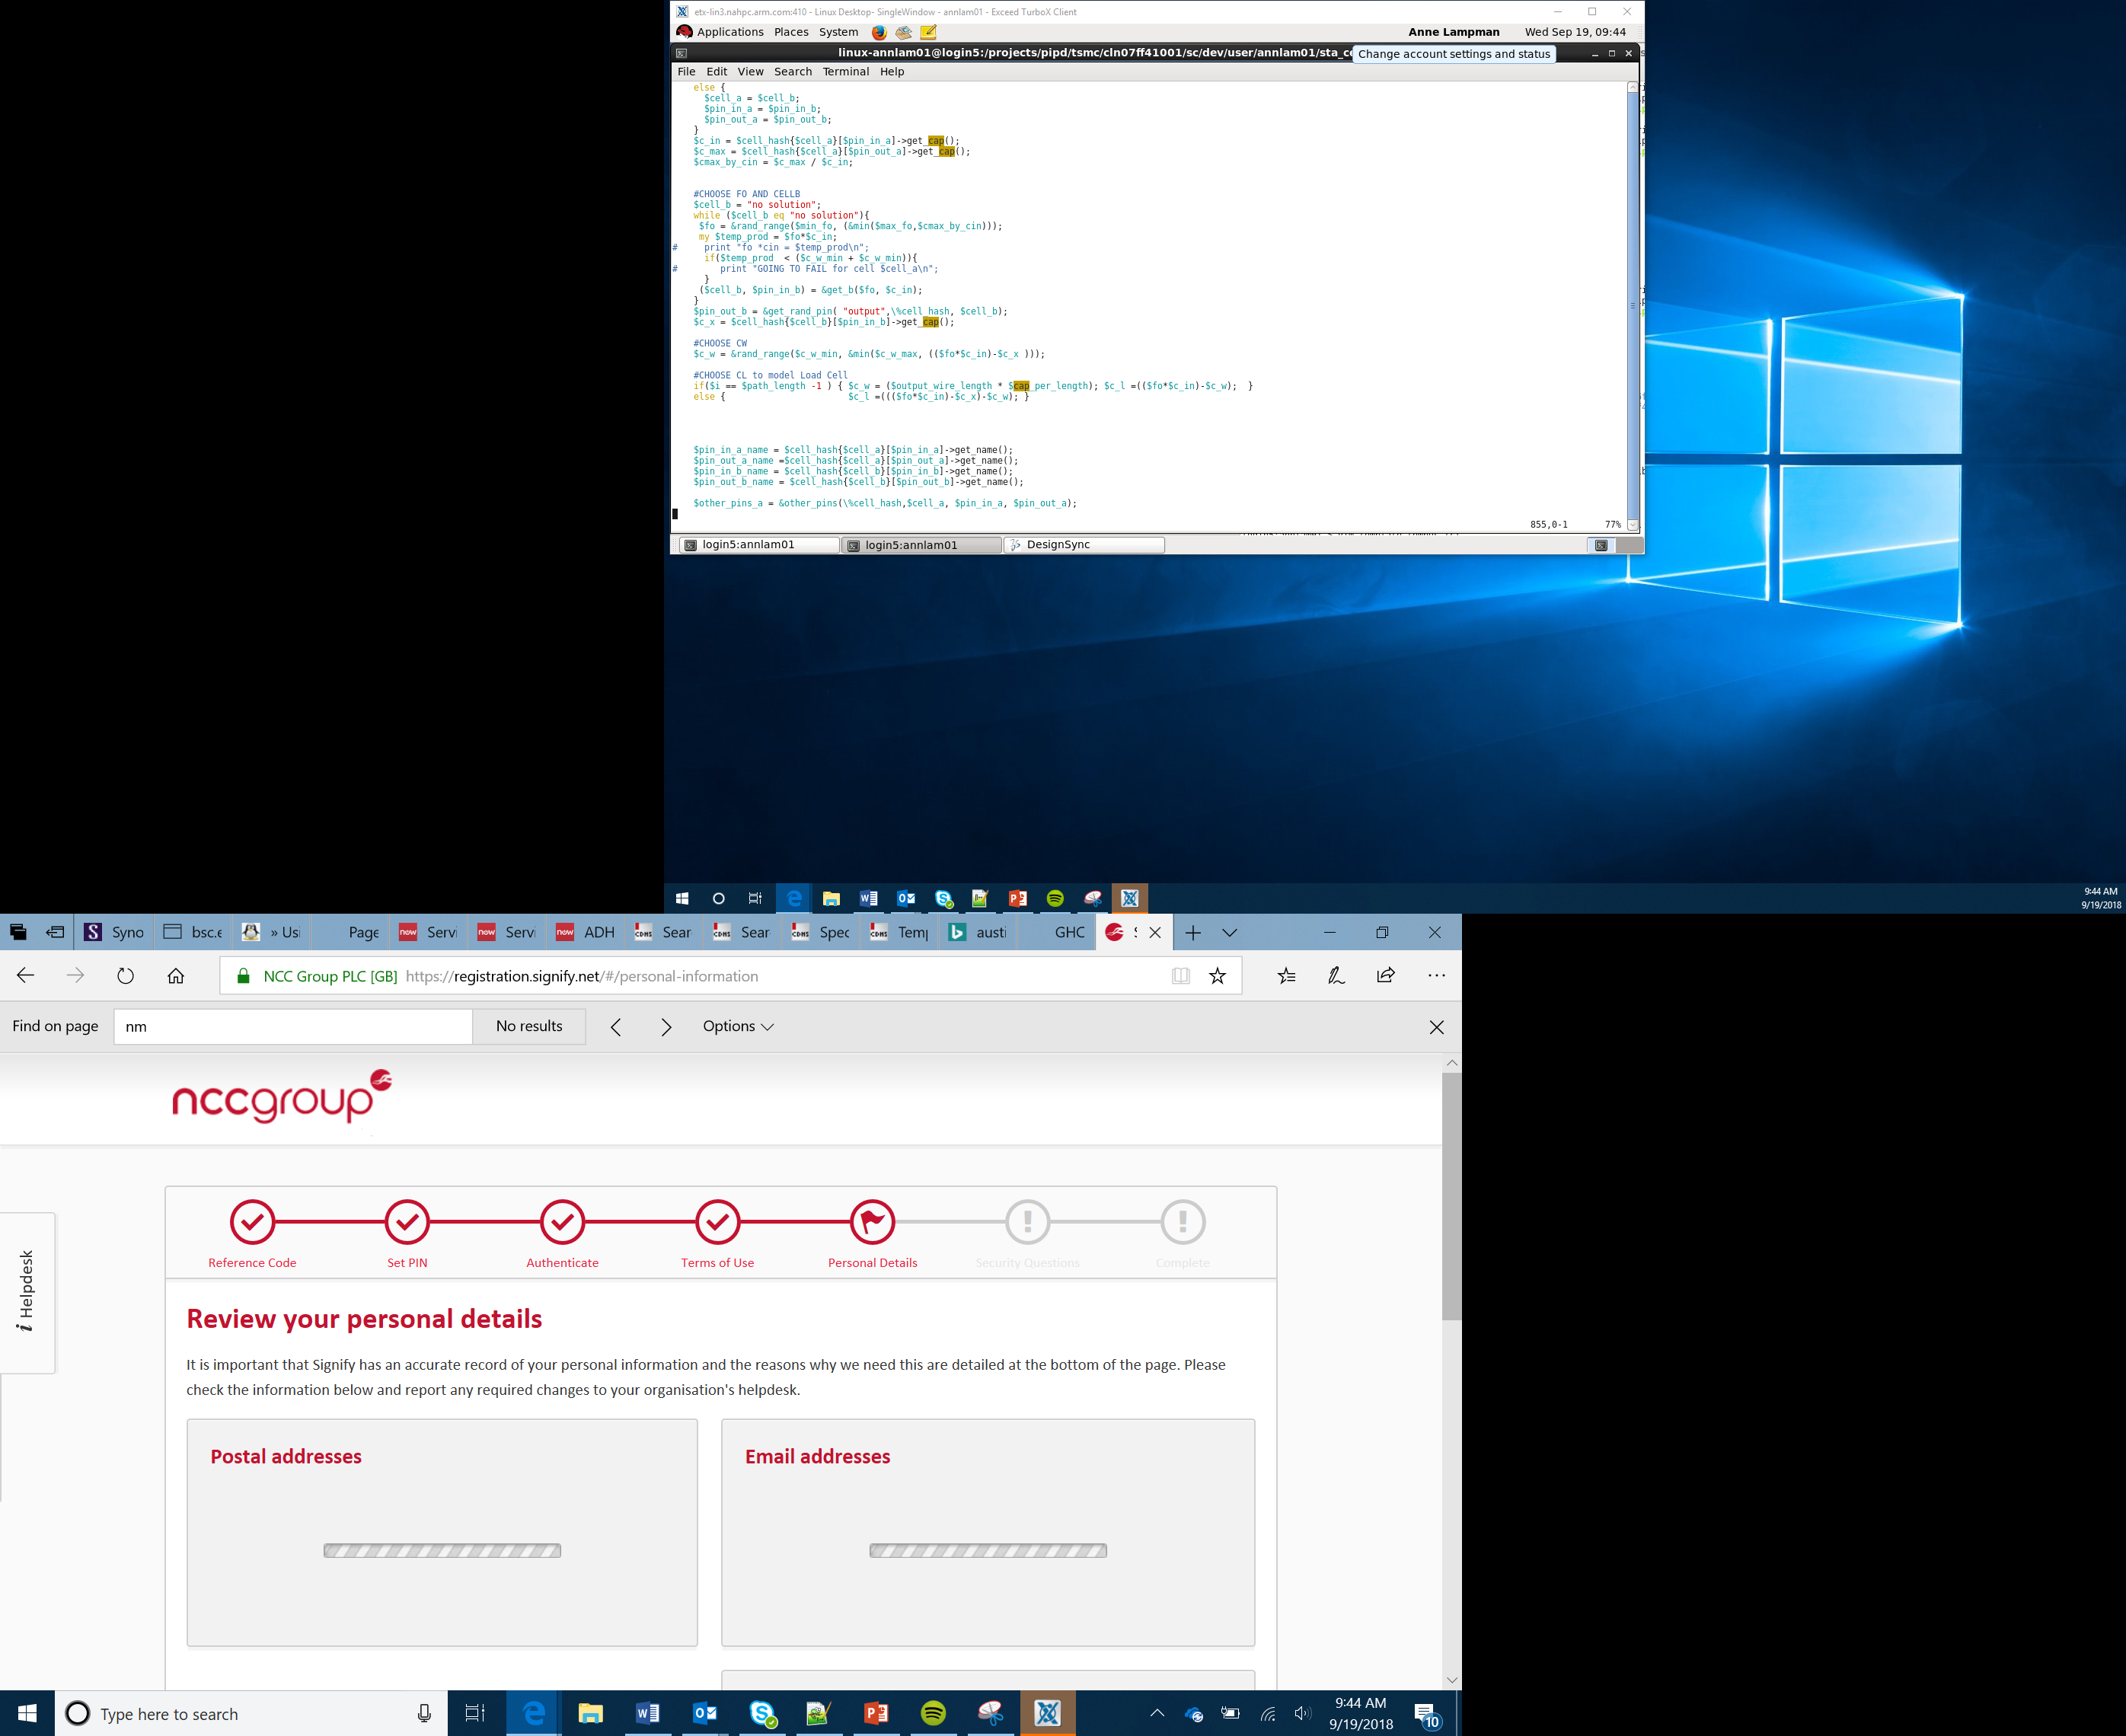

Making a Compass
Lesson 13

Slide 2

Making a Compass
A compass can be used to determine which direction you are pointing in
This can be useful when navigating
A compass can be used when reading a map to help you to ensure that you are heading in the correct direction
You can use your micro:bit as a compass
This Photo by Unknown Author is licensed under CC BY-SA

Slide 3
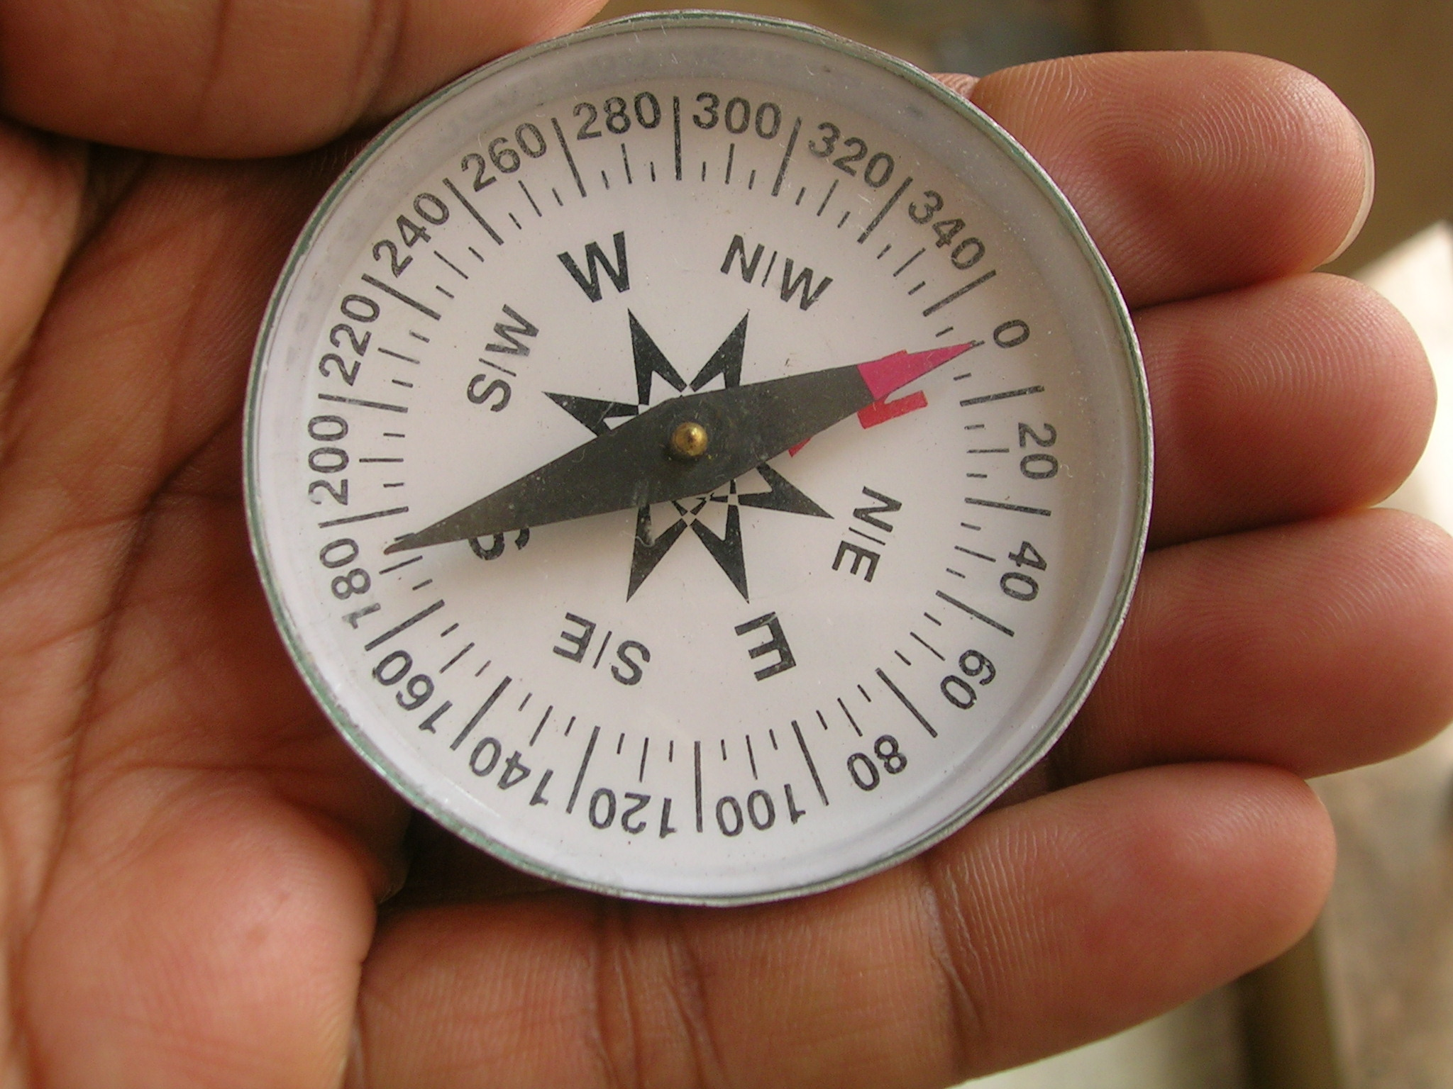
How Does a Compass Work?
The Earth is a magnet with a North Pole’ and South Pole
The end of a compass is a magnet that will align with the Earth’s magnetic field
The micro:bit has a built in compass called a magnetometer
This digital compass works by:
A current runs through a conductor
The voltage changes according to the Earth’s magnetic field
This is measured and used to determine the direction
This Photo by Unknown Author is licensed under CC BY-SA
Notes:
Learners do not need to understand how a compass works in detail. They should understand that a traditional compass works differently to an electronic one. Both can be used to indicate the direction in which a person is facing.

Slide 4
micro:bit Sensors
The micro:bit has a number of built-in sensors
One of the sensors can tell you which direction you are pointing in – your heading
This sensor will read the result of the direction you are pointing in as degrees
You can then write a program which will display whether the direction is North, East, South or West
If the number of degrees is measured as being less then 45 or more than 315 then you will be pointing North
Can you think what type of code structure could be used to program this?

Slide 5
Planning the Algorithm
Using the compass worksheet you should create a flow chart to plan your algorithm, using selection
Use the following rules to help you:
If the compass heading is less than 45 degrees or more than 315 degrees then you are pointing North
If the compass heading is less than 135 degrees then you are pointing East
If the compass heading is less than 225 degrees then you are point South
Else you are pointing West

Slide 6
Writing the Code
You are now going to create your own compass on your micro:bit using If Then Else loops
When the sensor determines the compass heading you will need to save this as a variable
Remember that a variable is a named location in memory where you can store data
Work through the ‘Compass’ Worksheet to help you write your code on the MakeCode website
If you complete the task can you try the Stretch Tasks to include the directions North East, South East, South West or North West

